Slide 1
Walmart Sales Forecasting
Omnia Abdulnabi

Slide 2
Project Description
Forecast weekly sales on department 16
Used Statistical Methods, Machine Learning, and Deep Learning to compare them and deploy the best model.
Deployed using FastAPI and Streamlit

Slide 3
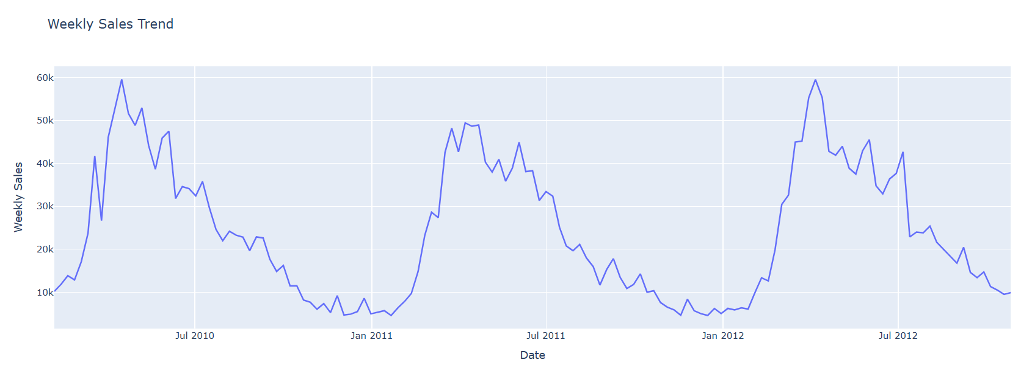
Section Title
Identify and Analyze Trends

Slide 4
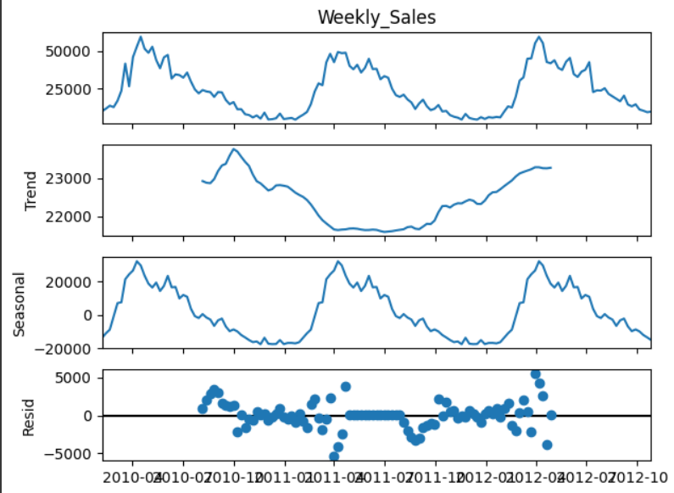
Section Title
Seasonal Decomposition

Slide 5
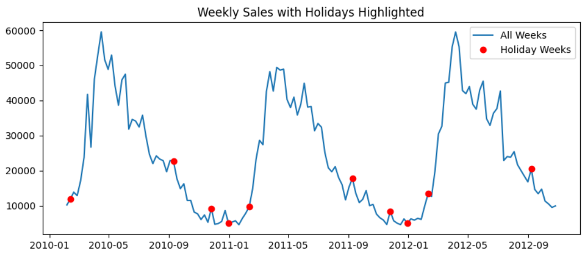
Section Title

Slide 6
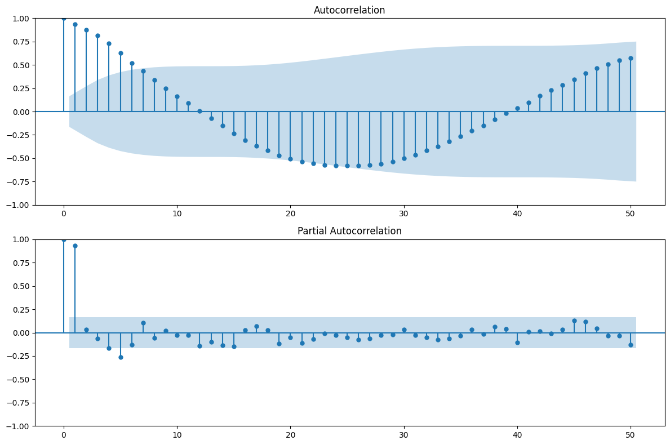
Section Title
ACF and PACF

Slide 7
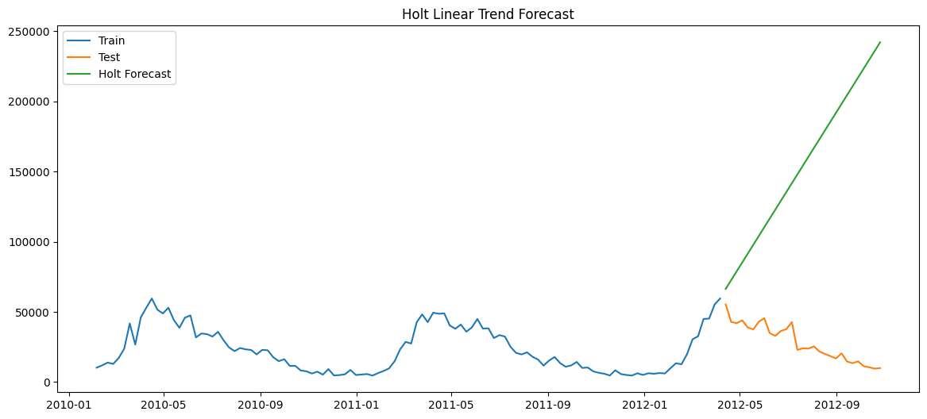
Section Title

Slide 8
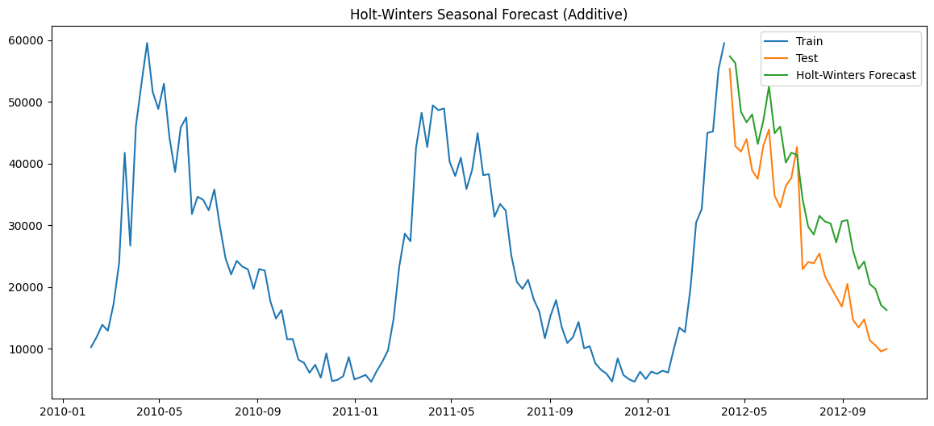
Section Title

Slide 9
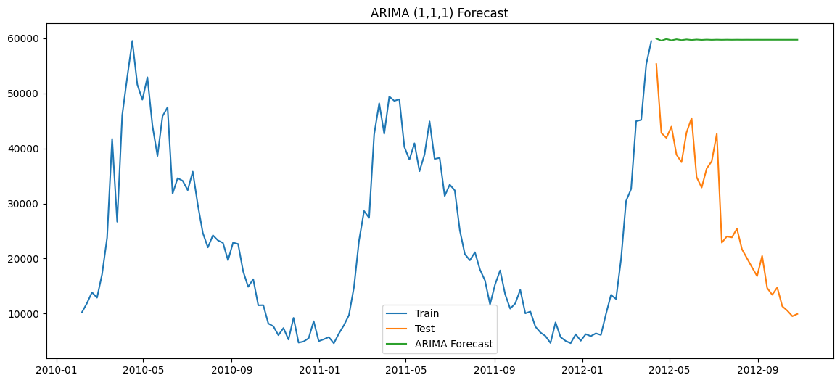
Section Title

Slide 10
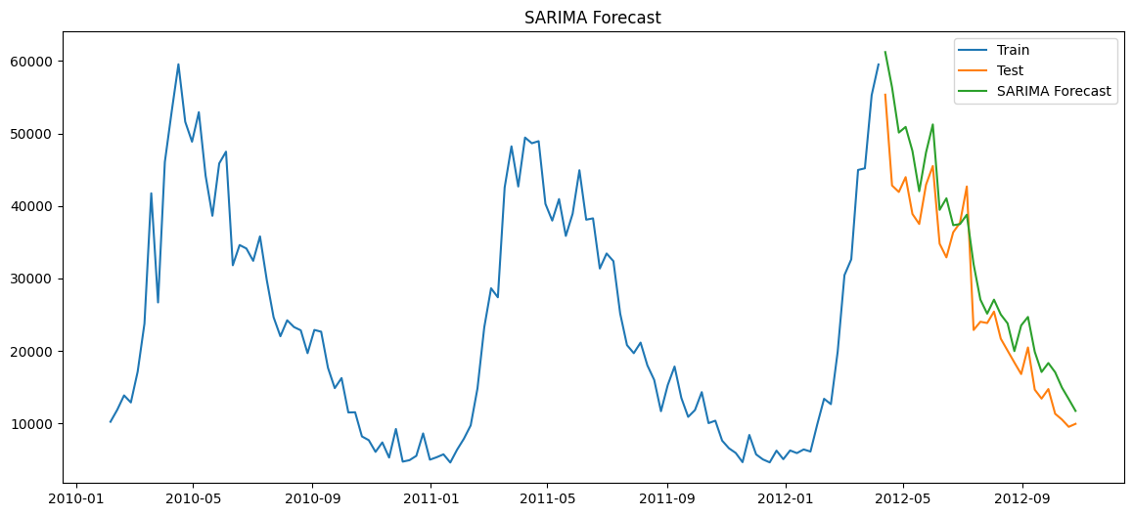
Section Title

Slide 11
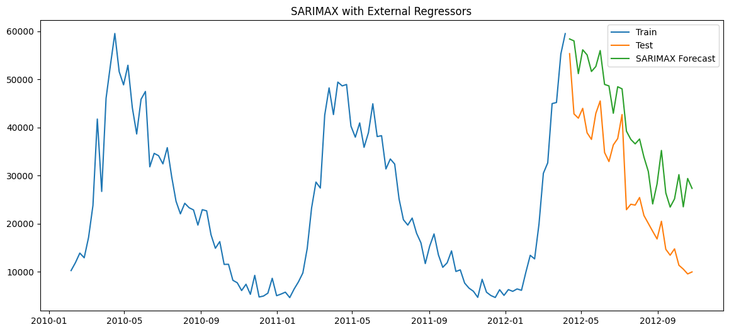
Section Title

Slide 12
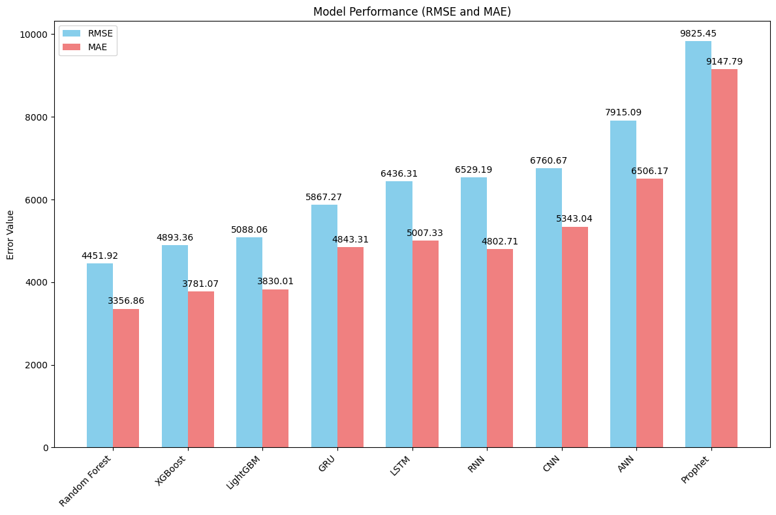

Slide 13
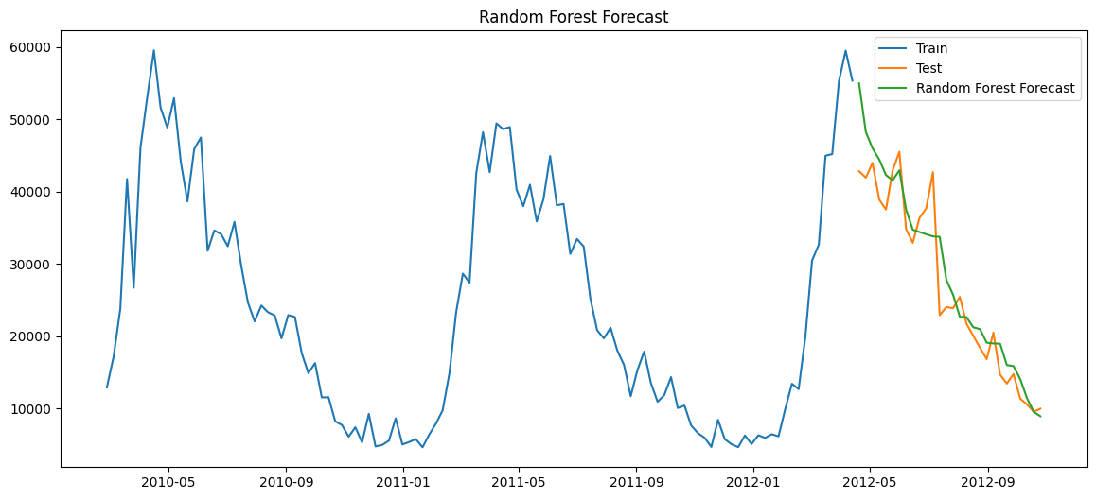
Section Title
This was the best model found due to the comparison between the previous models

